Slide 1


MONTHLY MARKET REVIEW AND Forecast
FOR MAY 2025
TRUSTFUND PENSIONS LTD RESEARCH
JUNE 2025

Slide 2


GLOBAL MARKET REVIEW
INVESTMENT RESEARCH
TRUSTFUND PENSIONS LIMITED
GLOBAL MACRO MOVERS FOR THE MONTH
In May 2025, global shares advanced as 90-day pause agreement between the U.S. and China on reciprocal tariffs.
U.S. stocks rebounded in May, reversing April's decline. The recovery was fuelled by reduced concerns over tariffs and solid Q1 corporate earnings. The information technology sector led the rally, with communication services and consumer discretionary sectors also posting strong performances.
Similarly, European stocks advanced last month as investor confidence returned following the tariff war pause between the U.S. and China. The industrials, information technology and financial sectors were among the top performing sectors.
The Japanese stock market saw a significant upswing, with the Nikkei 225 rising by 4.98%, largely fuelled by strong gains in large-cap stocks. Investor sentiment was boosted by encouraging developments in U.S.-China trade talks, which helped ease fears of a potential recession.
The NGX ASI soared by 562bps MoM to close at 111,742.01 index points, fuelled by positive sentiments around corporate earnings releases.
*NGX – Nigerian Stock Exchange Mainboard Index
*STOXX Europe 600 – Index that tracks top 600 companies across Europe
*Nikkei 225 tracks top 225 large companies across sectors in Japan
**S&P 500 tracks top 500 companies in USA
Source: Schroders, (2025), Reuters, (2025) Trustfund Research, (2025)

Slide 3

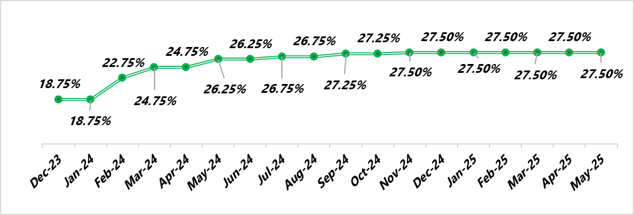

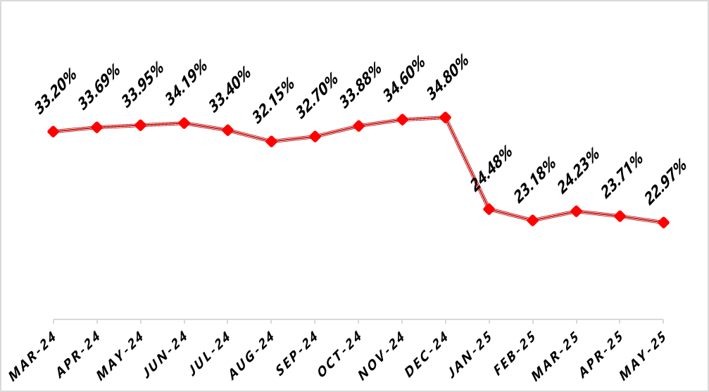

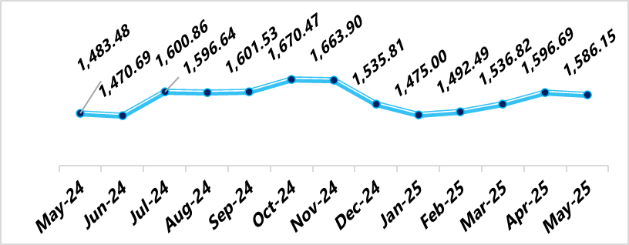

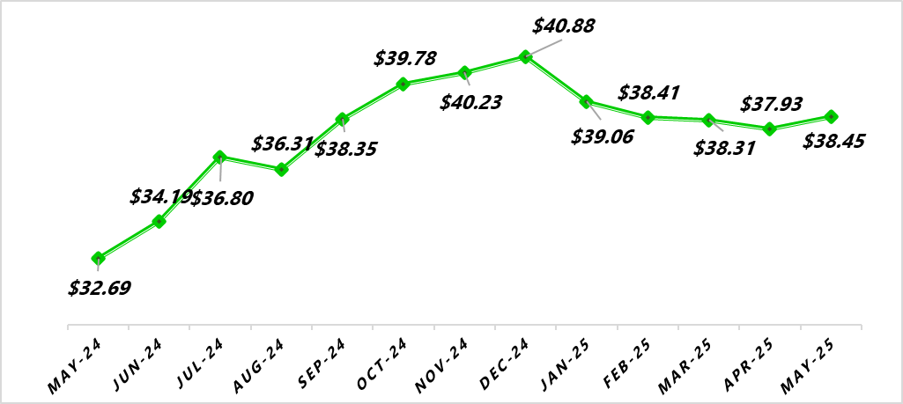
NIGERIAN MACRO REVIEW
MPR
CPI
The MPR was maintained at 27.50% as the MPC highlighted improved macro economic conditions from eased inflation, rising FX reserves and the Naira’s appreciation in the official and parallel windows. However, risks persist as oil prices have fallen below the $75 per barrel benchmark set in the 2025 budget.
Headline inflation eased further by 74bps to 22.97% following a reduction in food and energy prices last month. Consequently, Food inflation declined by 12bps to 21.14%, whilst and Core inflation dipped by 101bps to close at 22.28%.
FX RATE
RESERVE
In the official market, the Naira appreciated mildly by MoM against the greenback to close at NGN1,586.15/$1.00 supported by CBN’s continued efforts at currency stability.
In April, the country’s external reserves advanced to $38.45bn following increased oil revenue from risen crude oil prices. We expect this to persist in May as market catalysts remain unchanged.
copyright(c)Trustfund Pensions Limited

Slide 4

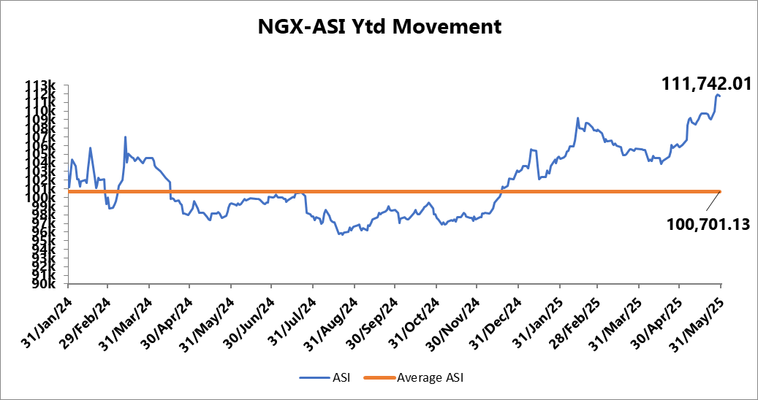
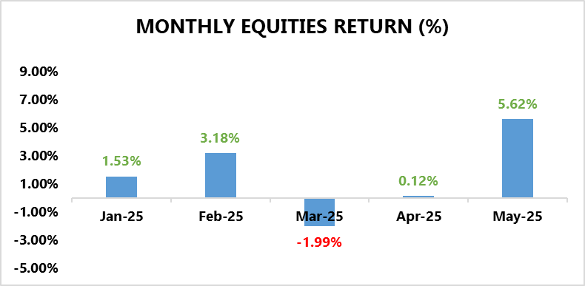
EQUITY MARKET
INVESTMENT RESEARCH
TRUSTFUND PENSIONS LIMITED
Bourse Extends its Bullish Streak in Response to Positive Corporate Earnings Releases
In May, the local bourse gained an additional 5.62% MoM to close at 111,742.01 index points underpinned by strong corporate earnings and sustained investor interest.
The top performers for the month were AIRTELAFRI (+10.00%), MTNN (12.04%), NB (32.56%), NESTLE (+44.59%), and INTBREW (+31.44%).
Sectoral performance was largely positive as only 1 out of the indices under our purview closed in negative terrain.
To illustrate, the Oil and Gas index closed 1.20% lower MoM moved by losses in ETERNA (-13.9%) and SEPLAT (-12.9%).
On the bright side, the Consumer Goods sector led market performance for the month, posting an 18.70% MoM gain, driven by strong earnings in NNFM (+85.2%), HONYFLOUR (+61.5%).
Additionally, The Industrial Goods and Banking indices recorded monthly gains of 2.4% and 1.9%, respectively, driven by strong performances in BETAGLAS (+158.9%), CUTIX (+40.7%), STANBIC (+13.3%), and ETI (+9.5%).
Furthermore, The Insurance index climbed by 1.6%, supported by notable price gains in CUSTODIAN (+24.4%) and LASACO (+19.9%).
Source: Bloomberg/ TFP Research

Slide 5
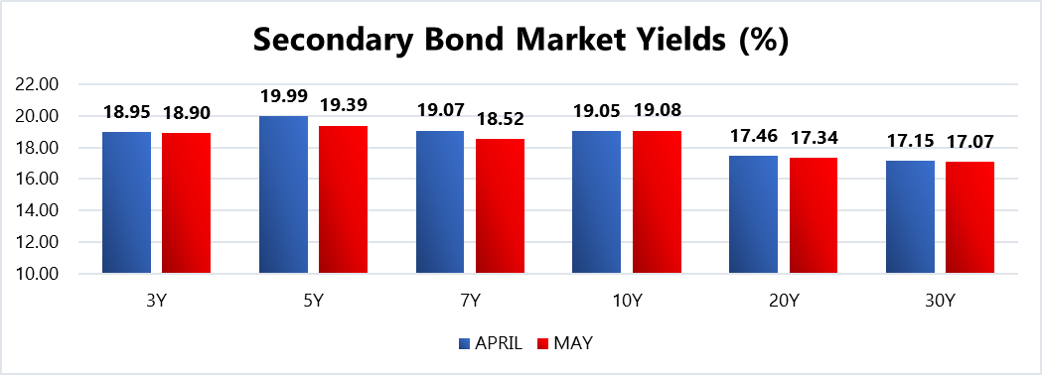
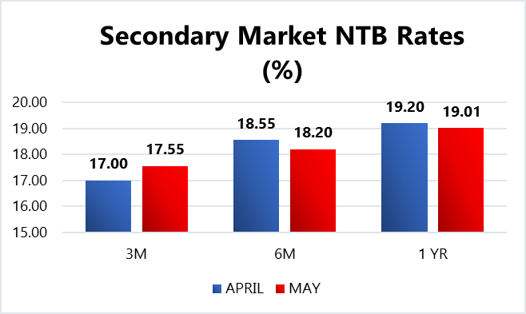
FIXED INCOME MARKET
INVESTMENT RESEARCH
TRUSTFUND PENSIONS LIMITED
In May, strong buying interests combined with easing inflation rates drove a bullish trading pattern in the domestic fixed income market.
As such, average bond yields shed 21bps MoM to close at 18.84%, whilst average discounted rates on secondary market NTBs slipped by 11bps to settle at 18.60% MoM.
In other news, the DMO conducted a bond auction where N300.00bn (N50.00bn less than last month’s auction) worth of two instruments namely the 19.30% FGN APR 2029 (N100.00bn) and the 19.89% FGN MAY 2033 (N200.00bn) were offered to participants. Eventually, the DMO sold slightly above what was offered (N300.69bn) was sold in total at respective average stop rates of 18.98% (prev.19.00%) and 19.85% (prev. 19.99%) despite subscription levels reaching N436.41bn. This translates into a bid to offer and bid to cover ratio of 1.45x.
Additionally, the DMO launched the 7th Series of the Sovereign Sukuk, aiming to raise N300.00bn at a rental rate of 19.75%. Expectedly, investor interest was exceptionally high, with total subscriptions reaching NGN2.20 trillion—an oversubscription of 735%. Nonetheless, the DMO maintained its original target by issuing its initial N300.00bn offer.
Confidential. Copyright © Trustfund Pensions Ltd

Slide 6
FIXED INCOME MARKET
INVESTMENT RESEARCH
TRUSTFUND PENSIONS LIMITED
Furthermore, there were two (2) NTB auctions held in May where a total of N1.05trn worth of the 91 DTM, 182 DTM and 364 DTM bills were rolled over and offered to investors. Eventually, N1.21trn worth of these bills were sold at respective average stop rates of 18.00% (prev. 18.25%), 18.50% (prev. 19.00%) and 19.60% (prev. 19.62%).
Also, subscription levels reached N2.26trn, indicating a bid to offer ratio of 2.15x and a bid to cover ratio of 1.86x.
Liquidity this month is projected at NGN2.41 trillion, down from NGN3.58 trillion in May, mainly due to maturities in FGN Bonds (NGN389.85 billion), NT-bills (NGN605.10 billion), and OMO bills (NGN1.25 trillion). As such, investor sentiment in the fixed income market is expected to remain positive, supported by easing inflation expectations and the Monetary Policy Committee’s continued pause on rate changes. Nonetheless, these are barring any radical global macroeconomic shifts/apex bank interventions/ liquidity shocks to the system.
Confidential. Copyright © Trustfund Pensions Ltd

Slide 7
MARKET OUTLOOK AND STRATEGY
INVESTMENT RESEARCH
TRUSTFUND PENSIONS LIMITED
In May 2025, Nigeria’s economy showed signs of resilience as inflation eased to 23.71%, supported by fuel price cuts and currency stability. The CBN maintained the MPR at 27.5%, while Moody’s upgraded Nigeria’s credit rating to B3 with a stable outlook. GDP growth remained strong, aided by fiscal reforms and FX liberalization. However, stalled oil-backed loans and output shortfalls, severe flooding, and insecurity presented risks. Looking ahead to June, the outlook is cautiously optimistic, with expectations of further disinflation, potential oil sector recovery, and prudent fiscal management, though external financing delays and climate-related disruptions could weigh on progress.
EQUITY
FIXED INCOME
We anticipate a bullish market next month, driven by selective buying as investors position ahead of Q2 earnings. The consumer goods and IT/communication sectors are expected to provide continued support. Although profit-taking may persist in some stocks, strong demand for fundamentally sound equities will likely influence overall market performance. Nonetheless, these expectations are barring any radical global macroeconomic shifts/apex bank interventions/ liquidity shocks to the system.
Bond – We expect yields to remain at double digit levels with a slight decline as investor focus shifts to the fixed income space in addition to easing inflation. As such we will monitor take advantage of suitable opportunities
Corporate Issuances – our focus will be on available ”A” rated corporate bonds at attractive yields to further boost portfolio return.
Treasury Bills – we expect yields to decline but remain at double digit levels. Thus, we will continue to monitor its trend and take position in yields not less than rates obtainable in money market.
Money Market – We expect rates to taper albeit at double digit levels due to high system liquidity expectations and yield corrections. As such, we will maximize the most attractive rates and support our liquidity laddering strategy, whilst ensuring safety of funds.
7
We will continue to take advantage of market opportunities with focus on corporate issuances and alternative assets to improve investment returns. As such, asset exposure may vary over time.
copyright(c)Trustfund Pensions Limited

