Slide 1


MONTHLY MARKET REVIEW AND Forecast
FOR MARCH 2025
TRUSTFUND PENSIONS LTD RESEARCH
APRIL 2025

Slide 2


GLOBAL MARKET REVIEW
INVESTMENT RESEARCH
TRUSTFUND PENSIONS LIMITED
GLOBAL MACRO MOVERS FOR THE MONTH
In March 2025, U.S. stocks saw sharp declines, with the S&P 500 dropping 5.75% amid escalating trade tensions and new tariffs. Investor concerns over inflation and weakened earnings outlooks fuelled volatility, with markets losing about $4 trillion in value for the month.
Eurozone stocks saw significant declines, with the STOXX 600 falling due to escalating trade tensions and U.S. tariffs. Fears of a global slowdown and weaker earnings projections hit sectors like luxury goods. However, defence and utilities sectors showed resilience amid growing military spending plans.
Japan's Nikkei 225 index experienced significant declines, primarily due to escalating trade tensions and the imposition of new U.S. tariffs. The index fell over 4% during the month, with major automakers like Toyota and Mazda seeing substantial stock drops. Additionally, a stronger yen and concerns over potential recession contributed to market volatility .​
The NGX ASI declined by 199bps to close at 105,670.36 index points, fuelled by investors’ efforts to take advantage of high yields in the fixed income space and profit taking activities.
*NGX – Nigerian Stock Exchange Mainboard Index
*STOXX Europe 600 – Index that tracks top 600 companies across Europe
*Nikkei 225 tracks top 225 large companies across sectors in Japan
**S&P 500 tracks top 500 companies in USA
Source: Stoxx, (2025), Reuters, (2025) Trustfund Research, (2025)

Slide 3

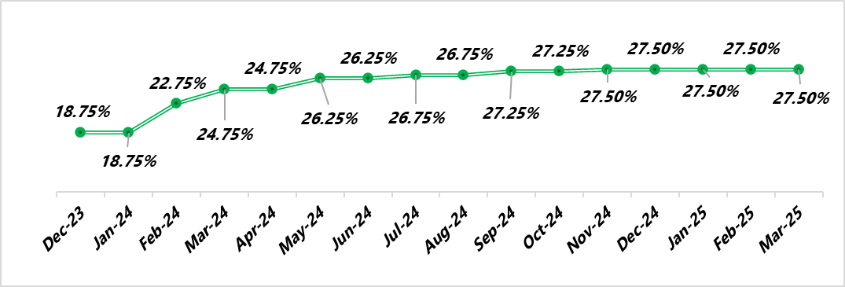

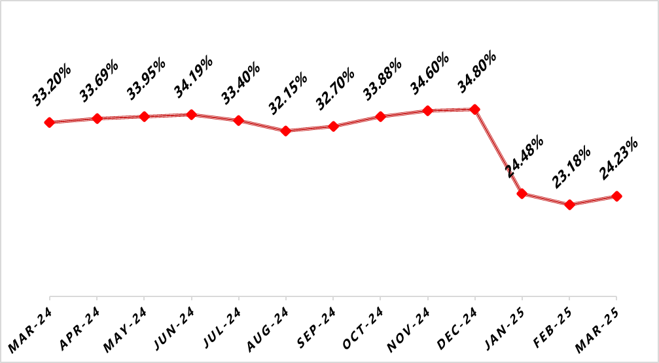

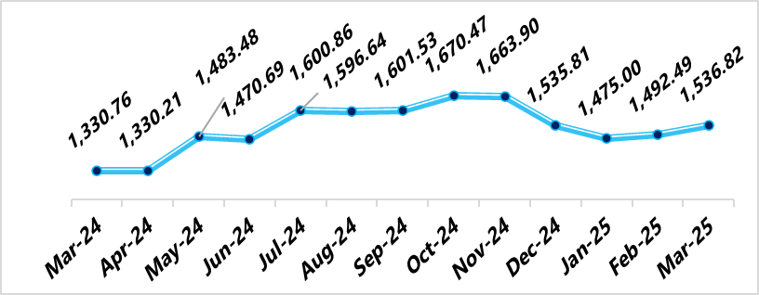

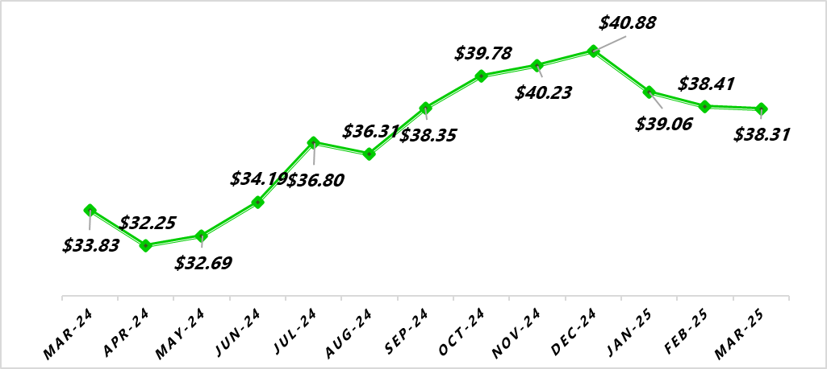
NIGERIAN MACRO REVIEW
MPR
CPI
The MPR remains at 27.50% as the MPR is yet to meet, though speculations of a rate cut in the next MPC scheduled for the 19th and 20th of May 2025 loom.
Headline inflation rose by 105bps to 24.23% following price increments in the core basket including energy prices. Food inflation declined by 172bps to 21.79%, whilst and Core inflation rose to 24.43%.
FX RATE
RESERVE
In the official market, the Naira declined by 3.10% MoM against the greenback to close at NGN1,538.82/$1.00. In the new month, we expect the naira to remain stable supported by CBN’s effort at currency stability policies.
In March, the country’s external reserves declined to $38.31bn following reduced oil revenue- driven by the U.S. imposed tariffs as well as the CBN’s continuous intervention in the FX market. We expect an uptick in April buoyed by increased oil production.
copyright(c)Trustfund Pensions Limited

Slide 4
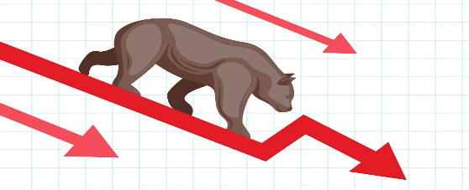
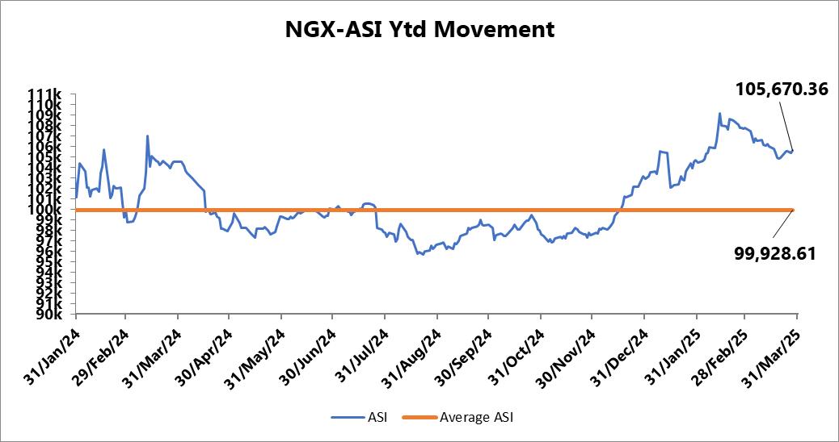
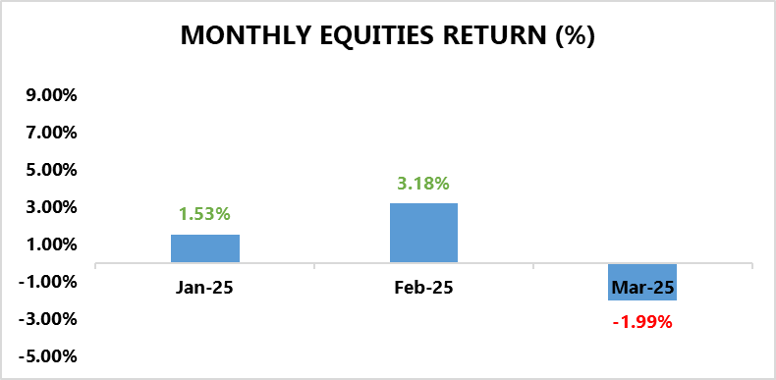
EQUITY MARKET
INVESTMENT RESEARCH
TRUSTFUND PENSIONS LIMITED
Bearish Sentiments Overwhelm the Bourse
In March, the NGX ASI declined by 199bps to close at 105,670.36 index points, fuelled by investors’ efforts to take advantage of high yields in the fixed income space and profit taking activities.
All the same, the corporate earnings results for FY2024 helped to cushion these effects.
Furthermore, sectoral performance reflected the broad market index as all sectors under our coverage closed in red terrain.
The Oil and Gas Index declined by 4.02%, anchored by losses in OANDO (-16.17% MoM), ETERNA (-14.64% MoM), ARADEL (-5.48% MoM) and MRS (-5.46% MoM).
This was followed by the Industrial Goods index, which declined 3.59% driven by price depreciations in BUACEMENT (-10% MoM) and BERGER (-9.81% MoM).
Also, The Insurance index was down by 2.48% following MoM losses in INTENEGINS (-19.40%), WAPIC (-16.15%) and SOVRENINS (-14.04%).
In the same vein, the Consumer Goods index depreciated by 1.30% driven by declines in DANGSUGAR (-17.25% MoM), AND CADBURY (-10.46% MoM) amongst others.
Finally, the Banking index declined by 0.49% as losses MoM in ACCESSCORP (-12.70%), WEMABK (-10.-8%) FCMB (-8.49%) offset gains in GTCO (12.42%), FIDELITYBK (6.74%). 130.48%) and MRS (63.13%).
Source: Bloomberg/ TFP Research

Slide 5
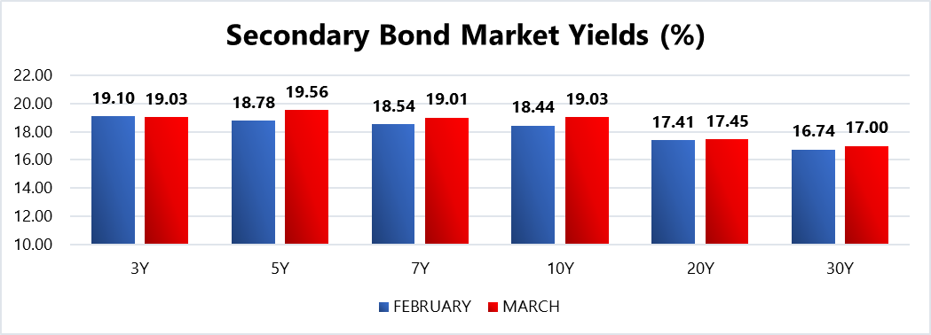
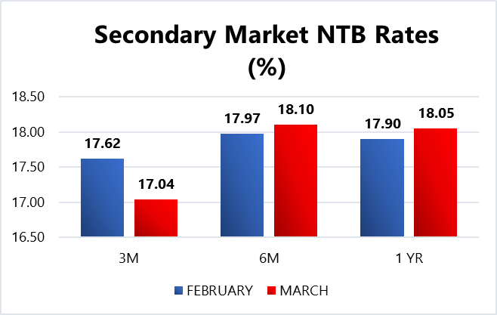
FIXED INCOME MARKET
INVESTMENT RESEARCH
TRUSTFUND PENSIONS LIMITED
The domestic bourse was characterized by price volatility last month ahead of the anticipation of a dovish stance by the MPC amid easing inflationary pressures.
As such, average NTB discounted rates shed 41bps MoM to close at 17.72%, whilst average discounted rates on FGN bonds expanded by 18bps MoM to close at 18.71%.
Furthermore, the DMO conducted a bond auction where N300.00bn worth of two instruments namely the 19.30% FGN APR 2029 (N200.00bn) and the 19.89% FGN MAY 2033 (N100.00bn) were offered to participants. Eventually, approximately N271.23bn was sold in total at respective average stop rates of 19.00% (prev. 19.20%) and 19.99% (prev. 16.00% in December 2024). Notably, the auction was 1.76x oversubscribed with a Bid to cover ratio of 1.96x.
Additionally, there were Four (4) NTB auctions held in March (one in each week) where a total of N1.70trn worth of the 91 DTM, 182 DTM and 364 DTM bills were rolled over and offered to investors. Eventually, N2.82trn worth of these bills were sold at respective average stop rates of 17.50% (unchanged), 18.07% (prev. 18.25%) and 18.95% (prev. 19.38%).
Also, subscription levels reached N5.52trn, indicating a bid to offer ratio of 2.05x and a bid to cover ratio of 1.96x.
Confidential. Copyright © Trustfund Pensions Ltd

Slide 6
FIXED INCOME MARKET
INVESTMENT RESEARCH
TRUSTFUND PENSIONS LIMITED
The heightened demand at these auctions suggests investors efforts to lock in at high yields in anticipation of an impending rate cut by the apex bank.
With the Monetary Policy Committee (MPC) hinting at a possible interest rate cut in its upcoming meeting, and the scheduled maturities of NGN349.93 billion in FGN bonds and NGN1.24 trillion in NT-Bills, the fixed-income market is positioned for a strong showing in April 2025. As investors seek to reinvest maturing funds in a falling interest rate environment, demand is likely to rise, supporting continued positive sentiment. Nonetheless, these are barring any radical global macroeconomic shifts/apex bank interventions/ liquidity shocks to the system.
Confidential. Copyright © Trustfund Pensions Ltd

Slide 7
MARKET OUTLOOK AND STRATEGY
INVESTMENT RESEARCH
TRUSTFUND PENSIONS LIMITED
In March 2025, Nigeria recorded a $6.83bn balance of payments surplus, supported by reforms such as subsidy removal and naira devaluation. However, falling global oil prices strained revenue and led to a revised budget. The government announced a strategic fuel reserve plan to ensure energy stability. Political tensions rose with a state of emergency in Rivers State. Looking ahead, GDP growth is projected at 3.2–4.17%, with inflation expected to moderate around 25%, despite ongoing external and political risks.
EQUITY
FIXED INCOME
The equities market may deliver a mixed performance in April 2025, as investor caution drives a shift toward high-yield fixed-income instruments ahead of a potential interest rate cut. Nonetheless, the release of Q1 2025 earnings could renew interest in Nigerian equities. Nonetheless, these expectations are barring any radical global macroeconomic shifts/apex bank interventions/ liquidity shocks to the system.
Bond – We expect yields to remain at double digit levels with a slight decline as investor focus shifts to the fixed income space. As such we will monitor take advantage of suitable opportunities
Corporate Issuances – our focus will be on available ”A” rated corporate bonds at attractive yields to further boost portfolio return.
Treasury Bills – we expect yields to decline but remain at double digit levels. Thus, we will continue to monitor its trend and take position in yields not less than rates obtainable in money market.
Money Market – We expect rates to taper albeit at double digit levels due to high system liquidity expectations and yield corrections. As such, we will maximize the most attractive rates and support our liquidity laddering strategy, whilst ensuring safety of funds.
7
We will continue to take advantage of market opportunities with focus on corporate issuances and alternative assets to improve investment returns. As such, asset exposure may vary over time.
copyright(c)Trustfund Pensions Limited

