Slide 1


MONTHLY MARKET REVIEW AND Forecast
FOR FEBRUARY 2025
TRUSTFUND PENSIONS LTD RESEARCH
MARCH 2025

Slide 2


GLOBAL MARKET REVIEW
INVESTMENT RESEARCH
TRUSTFUND PENSIONS LIMITED
GLOBAL MACRO MOVERS FOR THE MONTH
In February, U.S. stocks declined, while European markets saw stronger performance. Bond yields dropped (indicating higher prices) as concerns over slowing economic growth intensified.
U.S. stocks declined in February due to weaker economic data and concerns about trade tariffs' impact on the economy. Consumer discretionary and communication services were the worst-performing sectors, while consumer staples led gains. Investor sentiment was also dampened by uncertainty over the sustainability of earnings from mega-cap tech stocks, particularly those tied to AI.
Eurozone stocks rose in February, driven by strong performance in the financial sector, as banks benefited from solid earnings and shareholder return plans. Communication services also saw notable gains, while defence stocks within the industrial sector surged amid expectations of increased military spending by European governments.
The Nikkei 225 declined by 4.33%, as large-cap stocks struggled, especially in the technology and export sectors.
The NGX ASI gained 318bps to close at 107,821.39 index points, propelled by bullish sentiments on DANGCEM (+21.83%), MTNN (+5.68%), PRESCO (+34.19%), and TRANCOHOT (+9.99%).
*NGX – Nigerian Stock Exchange Mainboard Index
*STOXX Europe 600 – Index that tracks top 600 companies across Europe
*Nikkei 225 tracks top 225 large companies across sectors in Japan
**S&P 500 tracks top 500 companies in USA
Source: Stoxx, (2024), Schroders, (2024) Trustfund Research, (2024)

Slide 3

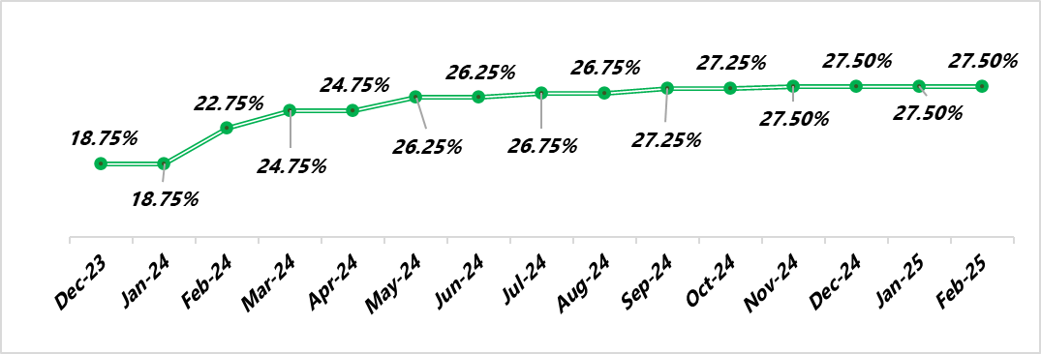

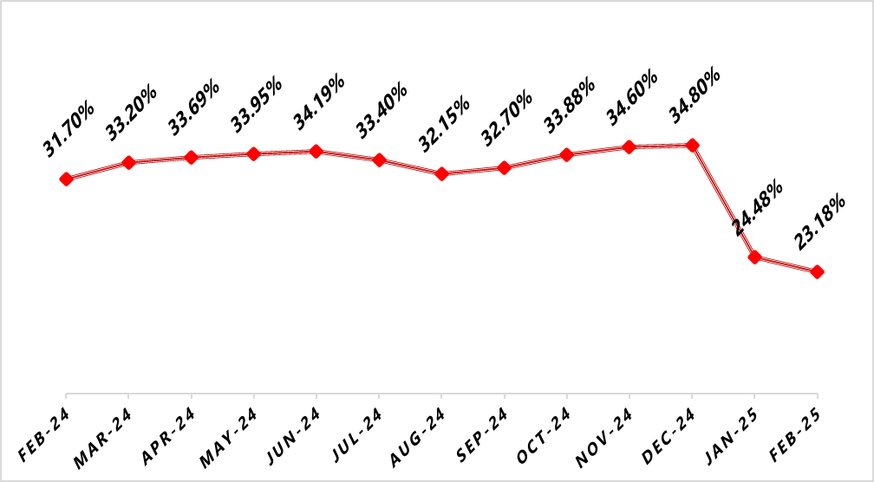

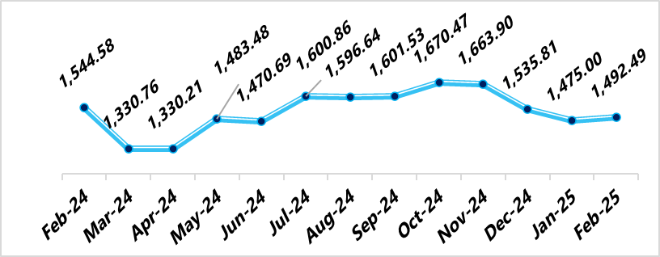

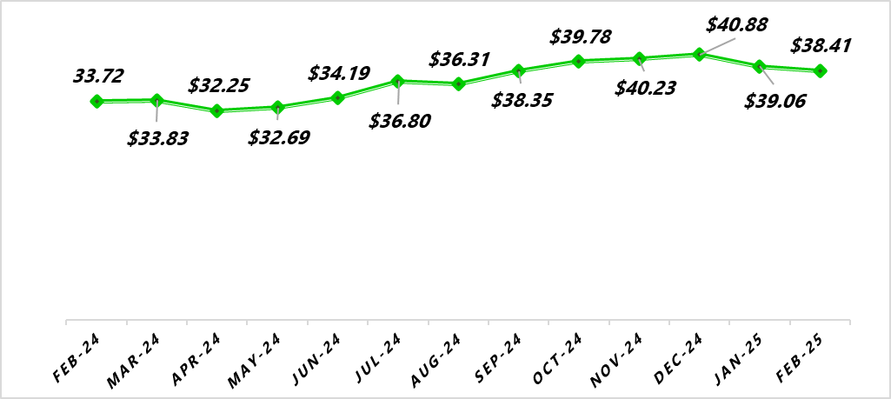
NIGERIAN MACRO REVIEW
MPR
CPI
The MPR was maintained at 27.5%, citing the Naira’s appreciation and lower petroleum prices as signs of stability. The committee emphasized the need for stronger government intervention to enhance food supply and security, ensuring sustained economic stability.
Headline inflation dipped further by 130bps to 23.18% owing to the base effect, slight reduction in PMS prices and relative currency stability. Food and Core inflation closed at 23.51% and 23.01% respectively.
FX RATE
RESERVE
The Naira depreciated by 1.19% MoM in the official market to NGN 1,492.49/$1.00, while the parallel market rate appreciated by 9.46% to NGN 1,500/$1.00. Moving forward, the Naira is expected to maintain a positive trend, supported by the CBN’s ongoing efforts to stabilize the currency.
In February, the External Reserve shed $1.31bn to close at $38.41 in February 2025 as crude oil prices fell during the same period. We expect further declines due to the uncertainty around the proposed US trade tariffs and the Russia-Ukraine crisis pressure oil prices.
copyright(c)Trustfund Pensions Limited

Slide 4

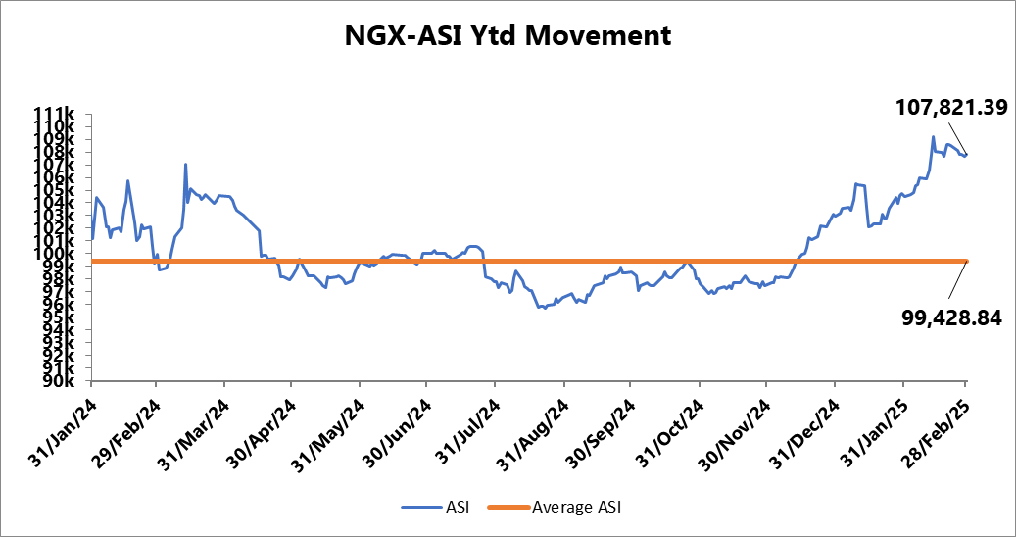
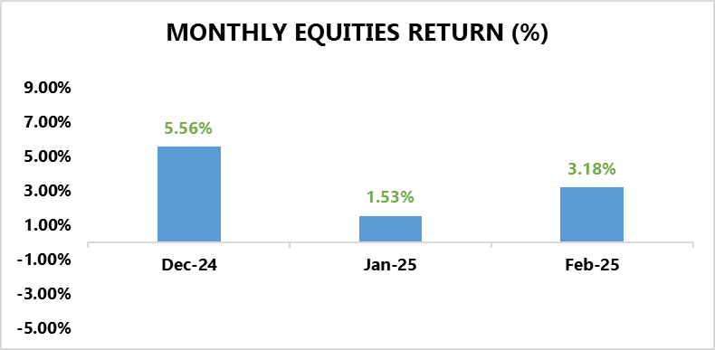
EQUITY MARKET
INVESTMENT RESEARCH
TRUSTFUND PENSIONS LIMITED
Bulls Maintain their Hold on the Bourse
In January, the NGX ASI soared by 318bps to close at 107,821.39 index points, propelled by bullish sentiments on DANGCEM (+21.83% MoM), MTNN (+5.68% MoM), PRESCO (+34.19% MoM), and TRANCOHOT (+9.99% MoM).
These gains outweighed price declines in ARADEL (-7.08% MoM), OANDO (- 15.13% MoM), ZENITHBANK (-4.45% MoM), and FIDELITYBK (-8.48% MoM).
A cursory sectoral overview revealed that only 3 out of 5 indices under our purview closed in positive terrain.
The Industrial Goods index gained 10.78% MoM, making it the top-performing sector, driven by strong investor confidence in DANGCEM (+21.83% MoM). This surge followed Aliko Dangote’s announcement of a $400 million investment to add a second production line at Ethiopia’s Mugher cement plant, aiming to double its annual output to 5 million tonnes within 30 months.
This was followed by the Consumer Goods (+1.70% MoM) and Insurance (+0.87%) indices driven by price increments in PZ (+53.91% MoM) and CONHALLPLC (+27.45% MoM) respectively.
On the flip side, the Oil and Gas (-4.00% MoM) index registered the steepest decline, buoyed by bearish sentiments in ARADEL (-7.08% MoM), OANDO (-15.13% MoM), and CONOIL (-4.96% MoM).
Additionally, The Banking index declined by 2.07% MoM, weighed down by sell-offs in major Tier 1 stocks, including ZENITHBANK (-4.45% MoM), UBA (-2.39% MoM), and FBNH (-2.17% MoM), which negatively impacted overall sector performance. 130.48%) and MRS (63.13%).
Source: Bloomberg/ TFP Research

Slide 5
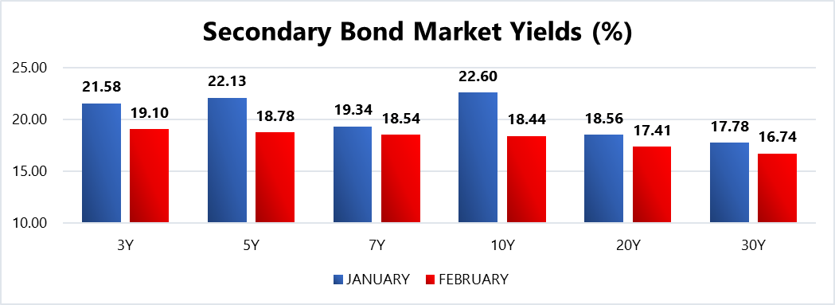
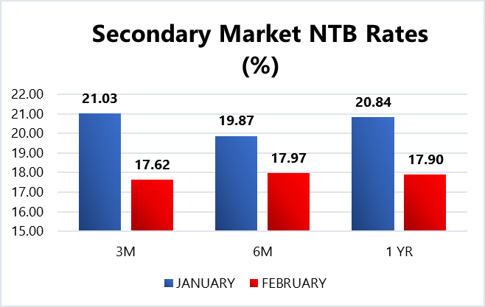
FIXED INCOME MARKET
INVESTMENT RESEARCH
TRUSTFUND PENSIONS LIMITED
The local fixed income market expressed bullish sentiments last month with average bond yields shedding 2.16% to close at 18.53%, whilst average discounted rates on NTBs shed 280bps to settle at 18.13%.
This performance can be hinged on;
  Improved system liquidity during the month, prompting investors to seek outlets to invest their excess liquidity positions
  Investors strategic efforts to lock in higher yields amid expectations of yield corrections following the CPI rebasing exercise leading to a decline in inflation figures; in addition to expectations of an eased stance from the apex bank on interest rates.
Moreover, in a surprising turn of events, the DMO removed the on-the-run 10-year bond (2035) from its February 2025 auction, deviating from its previously stated auction schedule. This move unsettled the market, sparking significant buying interest as traders rushed to cover their short positions, which ultimately pushed rates lower.
In other news, the DMO held an FGN bond auction during the month offering up to N350.00bn worth of the 18.50% FGN FEB 2031 and 19.30% FGN APR 2029 instruments were offered to auction participants.
Confidential. Copyright © Trustfund Pensions Ltd

Slide 6
FIXED INCOME MARKET
INVESTMENT RESEARCH
TRUSTFUND PENSIONS LIMITED
Eventually, the FGN sold approximately N910.39bn worth of these instruments to investors at respective stop rates of 19.33% (prev. 22.50%) and 19.20% (prev. 21.79%) Notably, the auction drew bids that were 4.66x the offer levels.
Additionally, there were two NTB auctions held in February where a total of N1.37trn worth of the 91 DTM, 182 DTM and 364 DTM bills were rolled over and offered to investors. Eventually, N1.44trn worth of these bills were sold at respective average stop rates of 17.50% (prev. 18.00%), 18.25% (prev. 18.50%) and 19.38% (prev. 22.21%).
Also, subscription levels reached N5.63trn, indicating a bid to offer ratio of 4.11x and a bid to cover ratio of 3.90x.
With the recently rebased inflation rate and signals from the MPC’s last meeting, we foresee a decline in interest rates in March. As a result, we expect the domestic fixed-income market to remain bullish, driven by higher system liquidity in March 2025 (NGN3.52trn compared to NGN3.34trn in February 2025). Nonetheless, these are barring any radical global macroeconomic shifts/apex bank interventions/ liquidity shocks to the system.
Confidential. Copyright © Trustfund Pensions Ltd

Slide 7
MARKET OUTLOOK AND STRATEGY
INVESTMENT RESEARCH
TRUSTFUND PENSIONS LIMITED
In February 2025, Nigeria’s economy saw inflation drop to 24.48% due to CPI rebasing, while the CBN held interest rates at 27.50%, signalling stability. The national budget was raised to N54.99trn, incorporating additional revenues and a $200mn healthcare allocation. GDP growth is projected at 4.17% in 2025, supported by fiscal and monetary reforms. Looking ahead to March, economic expansion is expected, driven by increased oil production and government policies. Inflation is likely to ease further, while the CBN may adjust interest rates later in the year to boost growth. Fiscal prudence will be essential to sustain economic stability.
EQUITY
FIXED INCOME
In March, the bearish sentiments witnessed in late February are expected to persist, driven by profit-taking and investor anxiety. However, these selloffs may create attractive buying opportunities in fundamentally strong stocks. Additionally, the release of banking sector FY’24 earnings and dividend announcements from both banks and other sectors will likely shape market trends. Nonetheless, these expectations are barring any radical global macroeconomic shifts/apex bank interventions/ liquidity shocks to the system.
Bond – We expect yields to decline albeit at double digit levels as yield corrections from the CPI rebasing exercise in addition to expectations of an easing stance on interest rates from the CBN persist. As such we will monitor take advantage of suitable opportunities
Corporate Issuances – our focus will be on available ”A” rated corporate bonds at attractive yields to further boost portfolio return.
Treasury Bills – we expect yields to decline but remain at double digit levels. Thus, we will continue to monitor its trend and take position in yields not less than rates obtainable in money market.
Money Market – We expect rates to taper albeit at double digit levels due to high system liquidity expectations and yield corrections. As such, we will maximize the most attractive rates and support our liquidity laddering strategy, whilst ensuring safety of funds.
7
We will continue to take advantage of market opportunities with focus on corporate issuances and alternative assets to improve investment returns. As such, asset exposure may vary over time.
copyright(c)Trustfund Pensions Limited

