Slide 1


MONTHLY MARKET REVIEW AND Forecast
FOR APRIL 2025
TRUSTFUND PENSIONS LTD RESEARCH
MAY 2025

Slide 2


GLOBAL MARKET REVIEW
INVESTMENT RESEARCH
TRUSTFUND PENSIONS LIMITED
GLOBAL MACRO MOVERS FOR THE MONTH
In April 2025, U.S. stocks fell in April, underperforming globally, as markets reacted to President Trump’s unexpected broad tariffs, including a 10% import tax and higher duties for major trade-deficit countries.
European markets ended the month lower, with early volatility from global trade tensions outweighing mid-month optimism. Sentiment had briefly improved following the EU's suspension of retaliatory steel and aluminium tariffs and Germany’s proposed boost in infrastructure and defence spending.
The Nikkei 225 outperformed, rising 0.3%, as Japan obtained priority status in tariff negotiations with the U.S. following “Liberation Day,” though no agreement was finalized by month-end. Also, Japanese firms began releasing full-year earnings and outlooks for the next fiscal year, which boosted market sentiments.
The NGX ASI inched up by 12bps MoM to close at 105,800.82 index points, fuelled by positive sentiments around corporate earnings releases.
*NGX – Nigerian Stock Exchange Mainboard Index
*STOXX Europe 600 – Index that tracks top 600 companies across Europe
*Nikkei 225 tracks top 225 large companies across sectors in Japan
**S&P 500 tracks top 500 companies in USA
Source: Schroders, (2025), Reuters, (2025) Trustfund Research, (2025)

Slide 3

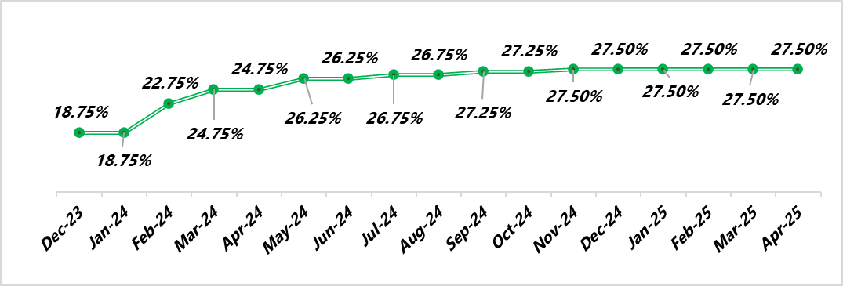

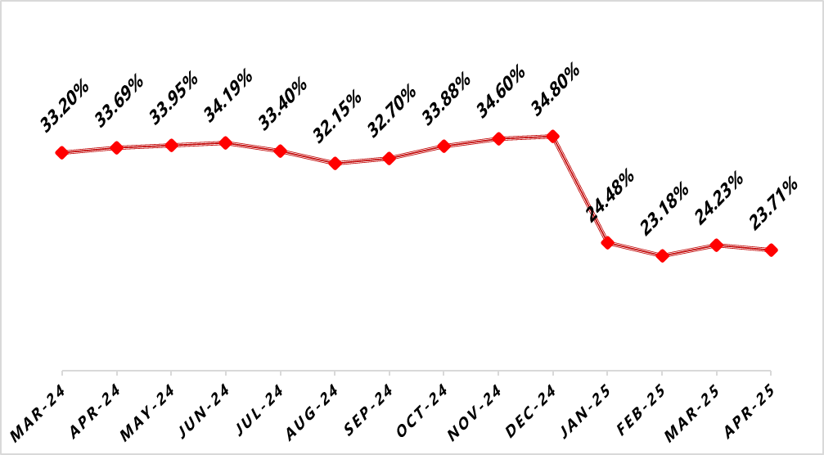

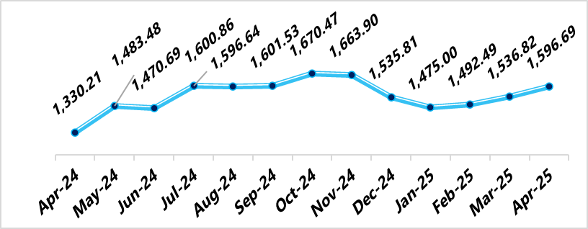

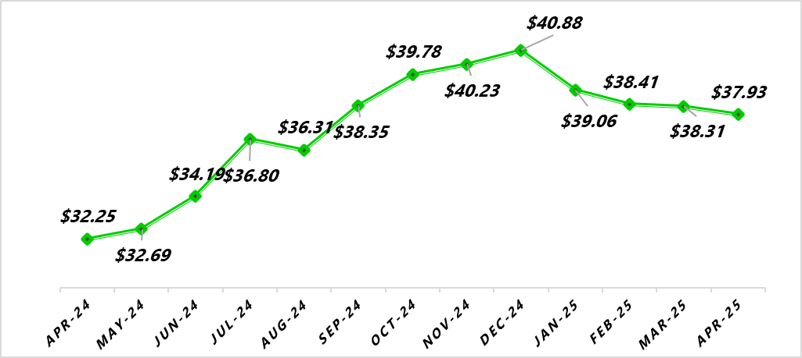
NIGERIAN MACRO REVIEW
MPR
CPI
The MPR remains at 27.50% as the MPR is yet to meet, though speculations of a rate cut in the next MPC scheduled for the 19th and 20th of May 2025 loom.
Headline inflation eased by 52bps to 23.71% following a reduction in food and energy prices last month. Consequently, Food inflation declined by 53bps to 21.26%, whilst and Core inflation dipped by 114bps to close at 23.29%.
FX RATE
RESERVE
In the official market, the Naira declined by 3.90% MoM against the greenback to close at NGN1,596.69/$1.00. In the new month, we expect the naira to depreciate further on the back of sustained demand for FX.
In April, the country’s external reserves declined to $37.93bn following reduced oil revenue- driven by the U.S. imposed tariffs pushing oil prices down. We expect this to persist in May as market catalysts remain unchanged.
copyright(c)Trustfund Pensions Limited

Slide 4

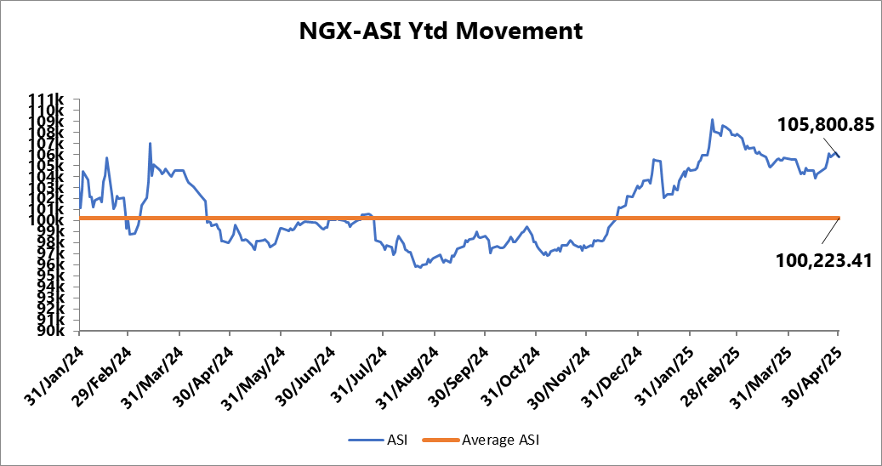
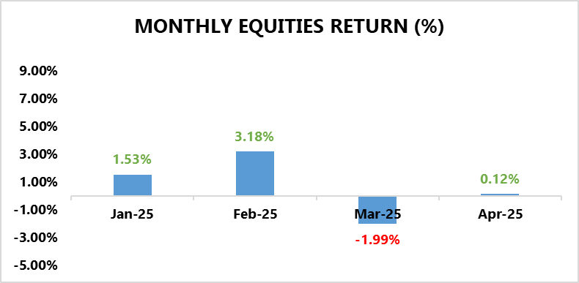
EQUITY MARKET
INVESTMENT RESEARCH
TRUSTFUND PENSIONS LIMITED
Bourse Rebounds on Corporate Earning Releases
In April, the NGX ASI inched up by 12bps MoM to close at 105,800.82 index points, fuelled by positive sentiments around corporate earnings releases.
Notable performers for the period included INTBREW (+44.71% MoM) and NB (+26.10% MoM), driven by strong Q1 2025 earnings that fuelled a broad rally in the Consumer Goods sector. VFDGROUP soared 135.17% MoM, buoyed by a 5-for-1 bonus share issue and a ₦2.50 dividend declaration, significantly boosting investor sentiment. WAPCO also gained momentum later in the month, rising 12.06% MoM following solid Q1 results and the announcement of a ₦4.00 interim dividend, which helped it recover from earlier losses.
From a sectoral standpoint, performance was negatively skewed as only 1 out of 5 sectors under our purview closed in positive terrain.
The Consumer Goods sector led market performance for the month, posting a 10.42% MoM gain, driven by strong earnings. INTBREW was the top contributor.
Conversely, The Banking sector declined by 1.52% MoM, weighed down by dividend markdowns from GTCO (-4.94% MoM) and UBA (-5.15% MoM). Optimism following the markdowns was not enough to lift the sector into positive territory.
The Insurance (-3.52% MoM), Industrial Goods (-3.59% MoM), and Oil & Gas (-4.23% MoM) sectors all closed the month lower, impacted by sharp declines in SUNUASSUR (-27.97% MoM), DANGCEM (-10.00% MoM), and ARADEL (-10.40% MoM), respectively.
Source: Bloomberg/ TFP Research

Slide 5
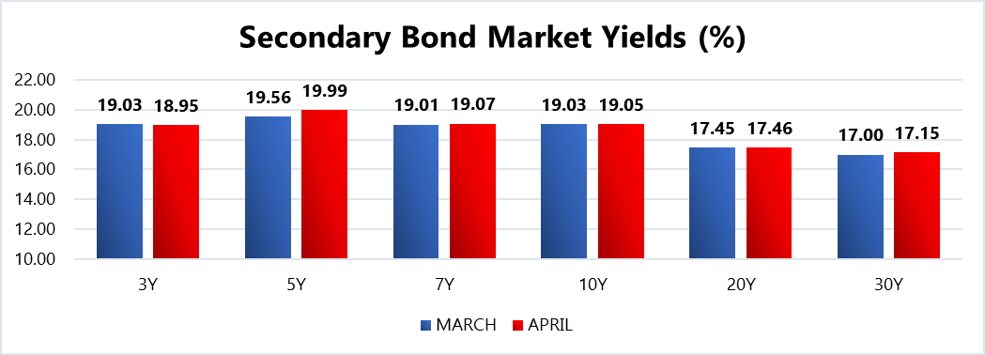
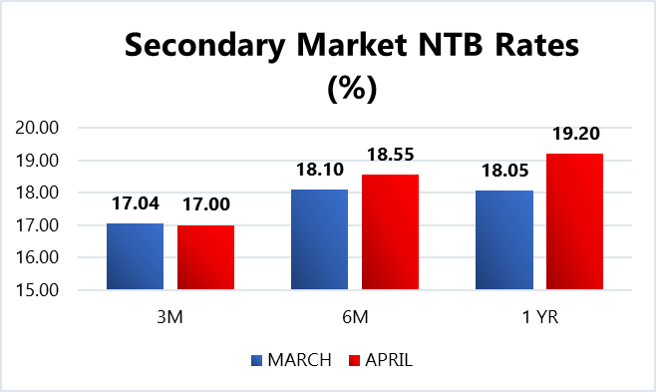
FIXED INCOME MARKET
INVESTMENT RESEARCH
TRUSTFUND PENSIONS LIMITED
In April, the secondary fixed income market was dominated by bearish trading patterns as yield appreciations were recorded along the curve.
For instance, average bond yields grew by 34bps. 19.05% as investors rotated out of long tenors in favour of instruments at the short end of the curve.
Furthermore, average discounted rates on NTBs gained 99bps to close at 18.71% with major sell offs on long to mid term instruments.
In other news, the DMO conducted a bond auction where N350.00bn worth of two instruments namely the 19.30% FGN APR 2029 (N200.00bn) and the 19.89% FGN MAY 2033 (N150.00bn) were offered to participants. Eventually, approximately N397.2390bn was sold in total at respective average stop rates of 19.00% (unchanged) and 19.99% (unchanged). Notably, the auction was 1.42x oversubscribed with a Bid to cover ratio of 1.25x.
Additionally, there were two (2) NTB auctions held in April where a total of N1.20trn worth of the 91 DTM, 182 DTM and 364 DTM bills were rolled over and offered to investors. Eventually, N1.14trn worth of these bills were sold at respective average stop rates of 18.25% (prev. 17.50%), 19.00% (prev. 18.07) and 19.62% (prev. 18.95%).
Also, subscription levels reached N2.67trn, indicating a bid to offer ratio of 2.22x and a bid to cover ratio of 2.34x.
Confidential. Copyright © Trustfund Pensions Ltd

Slide 6
FIXED INCOME MARKET
INVESTMENT RESEARCH
TRUSTFUND PENSIONS LIMITED
In May, expected inflows of N889.5bn from T-bills and N2.6trn from OMO maturities are set to boost liquidity in the financial system. This improved liquidity is likely to support a positive performance in the secondary T-bills market. With regards to bonds, the bearish trend is likely to persist due to uncertainty surrounding the upcoming MPC meeting and the renewed rise in inflation. This is despite an expected coupon inflow of up to N166.00bn. Nonetheless, these are barring any radical global macroeconomic shifts/apex bank interventions/ liquidity shocks to the system.
Confidential. Copyright © Trustfund Pensions Ltd

Slide 7
MARKET OUTLOOK AND STRATEGY
INVESTMENT RESEARCH
TRUSTFUND PENSIONS LIMITED
In May 2025, Nigeria's economy shows cautious optimism, supported by reforms like FX unification and subsidy removal. April saw moderate growth, driven by services and a rebound in oil output. Inflation remains high ,prompting tighter monetary policy. Fiscal reforms, including a VAT hike aim to boost revenue. However, food insecurity worsens due to climate-related agricultural disruptions, pushing up food prices. Nonetheless, the outlook remains positive if reforms stay on track, inflation is contained, and targeted support addresses food supply issues. Growth for 2025 is projected at 3.6% by the World Bank.
EQUITY
FIXED INCOME
The equities market may deliver a mixed performance in May 2025, as investor caution drives a shift toward high-yield fixed-income instruments ahead of a potential interest rate cut. However, the continued release of Q1 2025 earnings could renew interest in Nigerian equities. Nonetheless, these expectations are barring any radical global macroeconomic shifts/apex bank interventions/ liquidity shocks to the system.
Bond – We expect yields to remain at double digit levels with a slight decline as investor focus shifts to the fixed income space. As such we will monitor take advantage of suitable opportunities
Corporate Issuances – our focus will be on available ”A” rated corporate bonds at attractive yields to further boost portfolio return.
Treasury Bills – we expect yields to decline but remain at double digit levels. Thus, we will continue to monitor its trend and take position in yields not less than rates obtainable in money market.
Money Market – We expect rates to taper albeit at double digit levels due to high system liquidity expectations and yield corrections. As such, we will maximize the most attractive rates and support our liquidity laddering strategy, whilst ensuring safety of funds.
7
We will continue to take advantage of market opportunities with focus on corporate issuances and alternative assets to improve investment returns. As such, asset exposure may vary over time.
copyright(c)Trustfund Pensions Limited

